Slide 1
Introduction to Enterprise Architecture
Home of All the Laws of Nature
Notes:
last update: 4/3/2013

Slide 2
Enterprise Architecture
An overall architectural vision for an organization
An architecture in which the system in question is the whole enterprise, especially the business processes, technologies, and information systems .
Contains but is not limited to :
Process architecture
Applications architecture
Security architecture
Technology architecture
It’s Not Just the Enterprise IT
And what about software architecture, system architecture, solution architecture, infrastructure architecture…

Slide 3

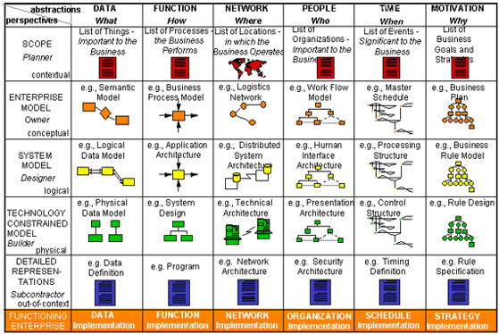


Zachman Enterprise Architecture Framework
One of Many...

Slide 4
Enterprise SOFTWARE Application
[Moderate to] Large
Multi-tiered, scalable, reliable, and secure network applications.
Designed to solve problems encountered by large enterprises.
Business Oriented
Meets specific business requirements; business policies,
processes, rules, and entities
Mission Critical
Sustain continuous operation, scalable and deployment,
provide for maintenance, monitoring, and administration.
Enterprise Design & Architecture - Microsoft
Notes:
What IS?

Slide 5
Software Architecture – Application Frameworks
Architecture is an abstract plan that can include design patterns, modules, and their interactions.
In this course we will focus on
Architecture Implementation or Realization
which incorporates
Frameworks - architected "physical" structures on which you build your application.
specifically we will use
The Spring Framework, an Enterprise Application
Development environment for building large scale enterprise applications.
Other Frameworks:
.NET
LAMP
Ruby-on-Rails
Grails
Jboss Seam
Google Guice
JEE 7 Container

Slide 6
LARGE Enterprise Architecture
ENTERPRISE CUSTOMER INTEGRATION
Enterprise Policy & Practices Coordination
Campaign Tracking
Prospecting/Lead
Tracking
Enterprise Customer Business Rules Management
Product Cross-Sell Tracking
Service Commitment
Tracking
Sales and
Service
Platforms
Enterprise Business Integration Services
Business Decisioning Support
Platforms
ATM
Customer Profiling
Enterprise Customer
Contact Services
Enterprise Referral Services
Risk Management Services
Kiosk
Enterprise Lead Services
Fraud Services
Industry
Standards
Industry
Standards
Privacy Services
Relationship Sales & Deals
(customized for customer)
Customer Request Services
Payment & Value Transfer Services
Kiosk
Enterprise Business Rule Engines
Profile Indicator Services
Customer Analytic/
Decisioning
Financial Plan Modeling
(customer self-service or WF agents)
Credit Decisioning
Loan Calculator
Sales/Pricing Configuration
Credit Indicator Services
Call Center
Enterprise Integrated Information for Sales & Service
Enterprise Integrated Info. For Analysis
Enterprise
Customer
Info & Rel.
Enterprise
Customer
Account
Summary
Enterprise
Customer
Contact
Enterprise
Referral
Customer
Request
Status
Enterprise
Sales/Deals
Enterprise
Product
Catalog
Enterprise
Org/WF
Rep
Enterprise
Leads
Enterprise
Data
Warehouse
Enterprise
Datamarts
Voice
Response
Workflow, BPM, Rules Engine,
SOA, COS Software,
ETL, EOD, SOD,
Reporting,
[Multiple] DBs,
[Multiple] LOBs
Enterprise Application Integration
Teller
Industry
Standards
Access and
Usage of
Enterprise
Services and
Information
Industry
Standards
Cross-
Business
Information
Agents
Industry
Standards
Contribute
to/Use
of Analysis
Results
Store
PRODUCT/SERVICE SYSTEMS (internal, outsource & partnership/alliances)
Field Rep
Internet
Cross Business Infrastructure Services
Common Distributed Infrastructure
Cross Business Messaging Srvcs.
Event Notification Services
Directory Services
Delivery Channel Services
Wireless Services
Cross-System Transactional Services
Data Services
(database/file)
Data Distribution Srvcs
Data Replication
Data Access
Data Trans./Conversion
Execution Services (S/w, H/w)
Object Brokering
Web Server
Application Server/OTM
Message Transports, Parsers
Load balancing Tools
Transactions
Core Infrastructure Services
Network
Naming Services
Operating Systems
Platform Security
Platform Systems Management
Security
Analytic Services
Alert Services
Enterprise Workflow Services
Enterprise Communication Srvcs
Data Warehouse Services
Hardware
Directory Structures
Backup/Recovery
Database
Systems Mngmt
Capability Stage:
Direction – No Progress
Initial: limited strategic functionality; production pilots or single LOB/channel use
Expanded: increased strategic functionality; limited Enterprise Information populated and used by a few LOBs/channels
Advanced: full strategic functionality; Enterprise Information populated by many LOBs; wide production use
Key:
Enterprise Shared, must
contribute & use
Business Line options with
integration requirements
Enterprise Standard - could be
more than one product
Notes:
Identify Workflow rules engine I/O sources EOD, SOD batch reporting SOA microservices COS software, Cross cutting
MANY DBs…MANY LOBs

Slide 7
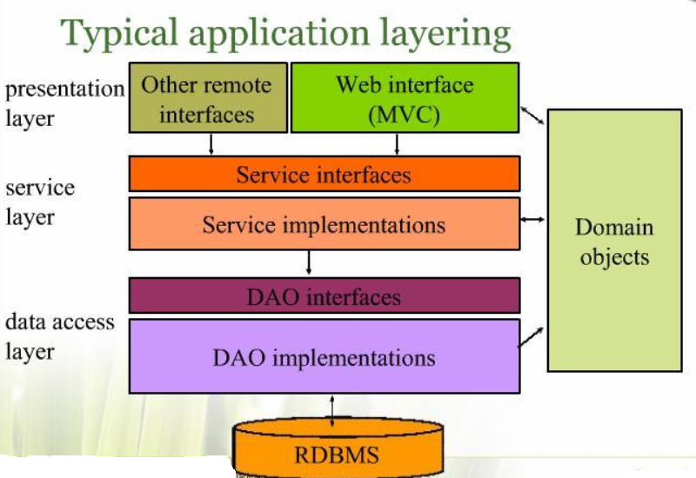
Underlying N-Tier Software Architecture
Separation of Concerns
Domain Model
central, organizing component
Design to Interfaces

Slide 8
Service Layer – Interface driven
public interface MemberService {
public void save(Member member);
public void update(Member member);
public List<Member> findAll();
public Member findByMemberNumber(Integer memberId);
}
ALWAYS design to Interfaces
For Service Layer -- Extra important
Extremely Important
Interface Driven
Basic Design Pattern
Separation of Concerns
Testability
Scalability
Adaptability
EXTRA -- Extremely Important

Slide 9
Implementation of MemberService
@Service
@Transactional
public class MemberServiceImpl implements MemberService {
@Autowired
private MemberDao memberDao;
public void save( Member member) {
memberDao.save(member);
}
public void update( Member member) {
memberDao.update(member);
}
public List<Member> findAll() {
return (List<Member>)memberDao.findAll();
}
public Member findByMemberNumber(Integer memberId) {
return memberDao.findByMemberNumber(memberId);
}
Spring Annotations to facilitate Application Management
“Auto-magic” Dependency Injection
Interface driven Data Access Layer

Slide 10
RESTful
Implementation of MemberService
@Service
public class MemberServiceImpl implements MemberService {
@Autowired
private MemberRestService memberRestService;
public void save( Member member) {
memberRestService.save(member);
}
public void update( Member member) {
memberRestService.update(member);
}
public List<Member> findAll() {
return (List<Member>) memberRestService.findAll();
}
public Member findByMemberNumber(Integer memberId) {
return memberRestService.findByMemberNumber(memberId);
}

Slide 11
“Types” of N-Tier architectures
Monolith
Single Project
Single Presentation layer
Boundaries between tiers “blur” over time
Technical Functional Layering
Project per functional layer [Presentation, Service,
Persistence, Domain]
Increase re-use
Clean layer separation
more flexible….scalable
Component Services Business
Project per business domain
“Services” oriented

Slide 12
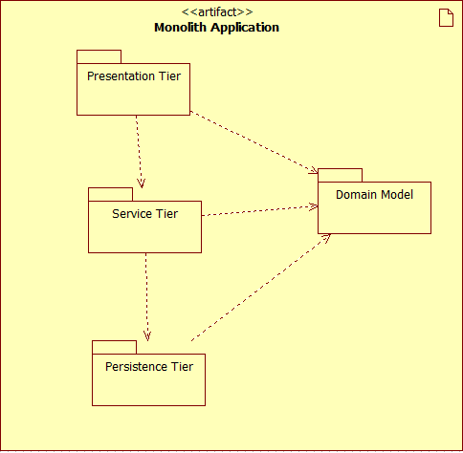
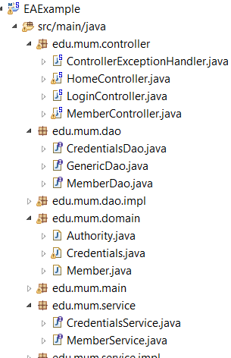
Monolith N-Tier

Slide 13
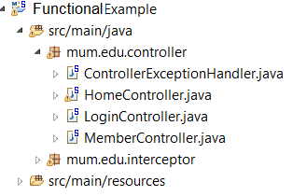
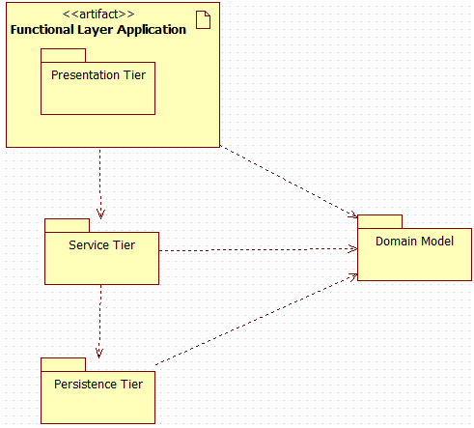
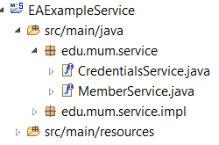
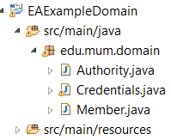
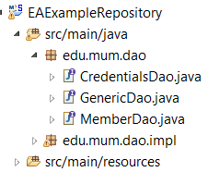
Functional N-Tier

Slide 14




Component N-Tier

Slide 15
Core N-Tier Enterprise Architecture
Position Statement
Corporate Enterprise Environments are an
Of Technologies
A “Java/Spring” shop is “maybe” 70-80% Java
New technologies arise to solve new use cases
Example: Consumer Web [2.0]
However, a consumer-facing technology is not necessarily the solution for core enterprise software infrastructure
So Our Focus will be:
Enterprise := N-Tier Architecture
“OLIO”

Slide 16
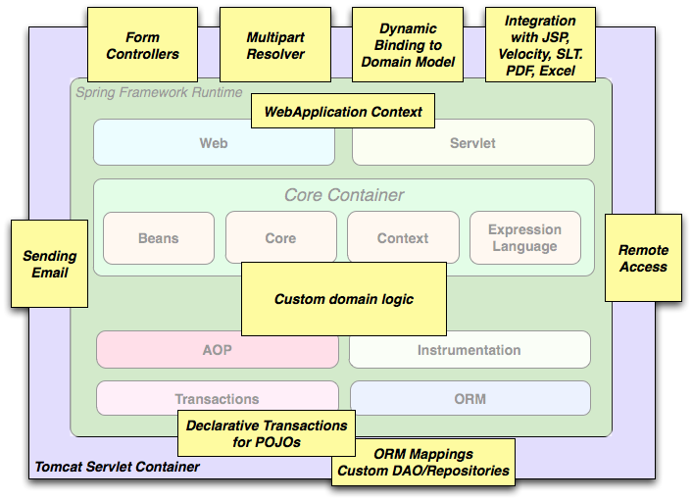
Spring N-tier Architecture
CS 544 EA Focus
15%
85%

Slide 17
Main Point
A software framework encapsulates the knowledge of experts, allowing the developers to take advantage of sound solutions and focus on the project qualities.
Science of Consciousness: Through the practice of Transcendental Meditation, a person taps the value of Pure Consciousness which encapsulates knowledge of all the laws of nature..

